Slide 1
BOATS
BOATS
BOATS

Slide 3
What are the features of this boat?

Slide 5
What are some differences about this boat?

Slide 6
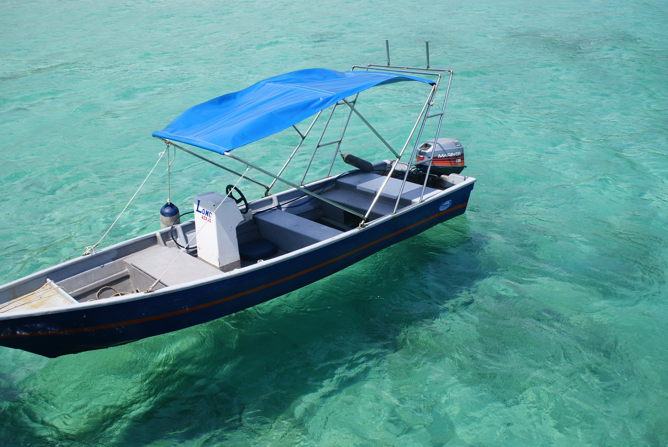

Slide 7
Let’s see if there is there is something different about this one…

Slide 9
Thinking time…
What are some of the similar features we seen between these boats?
How do you think they move?
How do you think they float?
What boat do you think would be the fastest?
Do you know any other boats?

